Slide 1
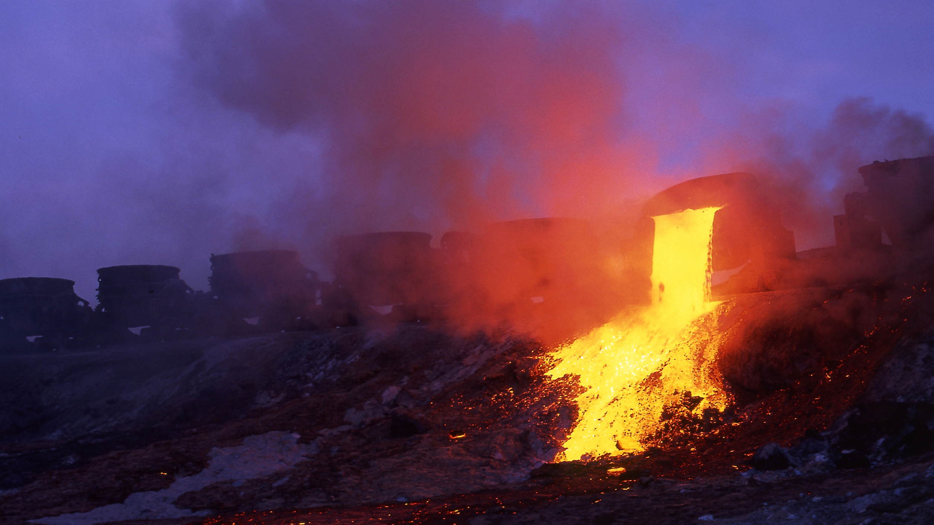
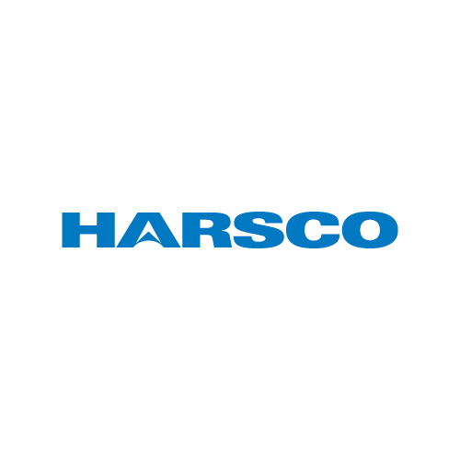
Optimizing the use of EAF
stainless steel Slag to
neutralize acid baths
Mattia De Colle
Pär Jönsson
Andrey Karasev
Alicia Gauffin

Slide 2
high alloyed
Optimizing the use of EAF
stainless steel Slag to neutralize acid baths
coming from the pickling process

Slide 3
Why so niche
*Jernkontoret:
Use of slag in Sweden (2010)

Slide 4
Changing perspective
Slag
Recycling
Converting waste into new products
Tool
Carries out specific functions
Re-use
Increasing the life span
By-Product
Incidential & secondary

Slide 5
Waste Hierarchy
*Brochure: The EU’s approach
to waste management (2008)
+ Desirable
Reduce
Reuse
Recycling
Recover
- Desirable
Dispose

Slide 6
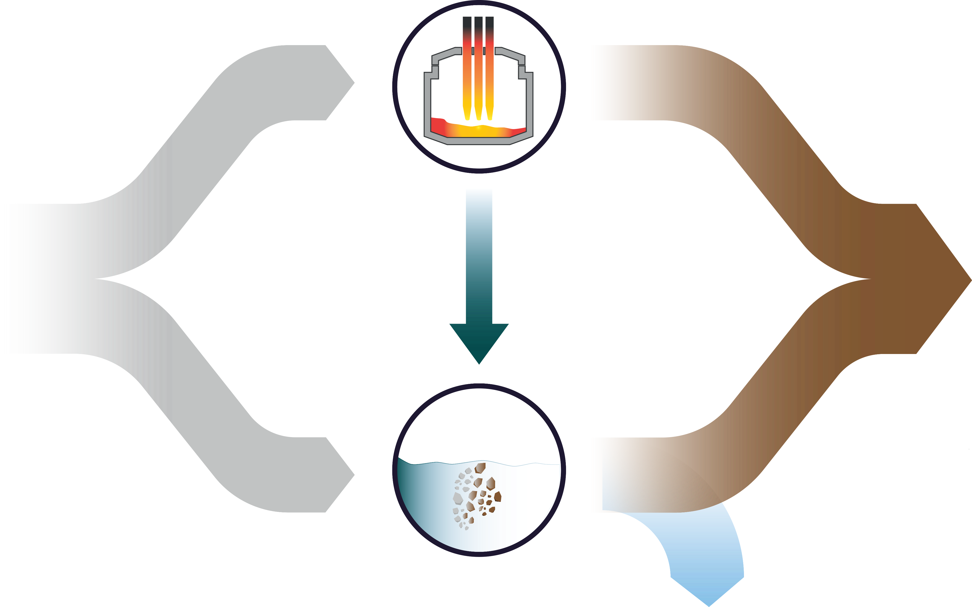
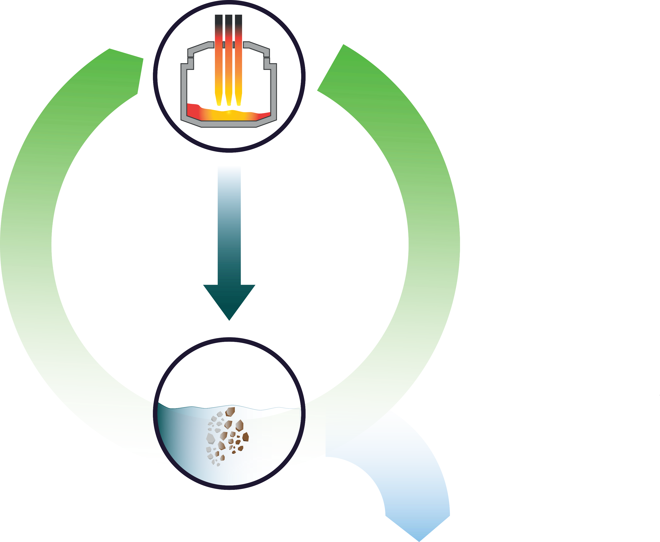
Extending slag lifespan
EAF Steelmaking
Slag builders
Slag
Natural
world
Waste
Waters
Saturated Slag
Landfill
Lime
Saturated Lime
1st trials
H2O
Neutralization

Slide 7
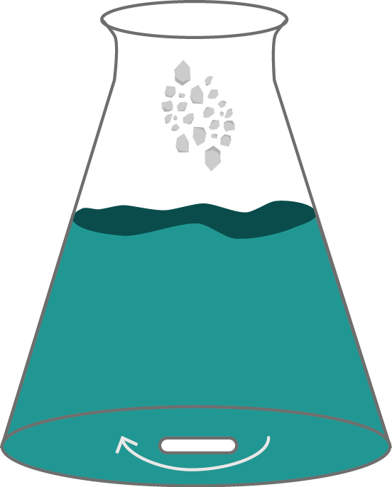
Neutralization Setup
Slag Properties
Mass
Particle size
Mineral content
Origin
pH
WW Properties
Volume
pH, Cr, Ni, F, Fe, Mo
(before and after)
t

Slide 8
Mass dependent (slag<63 µm)
Lime (5g, 15 µm)
Slag (23g)
Slag (20g)
Slag (15g)

Slide 9
Particle size dependent

Slide 10
Composition dependent (slag<63 µm)

Slide 11
WW
Composition
(mg/L)
 | Cr | Ni | Fe | Mo | F
Before Neutralization | 434.00 | 358.00 | 664.00 | 42.00 | 1230.00
Lime Neutralization | 0.08 | 0.27 | 0.12 | 8.93 | 5.53
Slag Neutralization | 0.13 | 0.32 | 0.05 | 7.83 | 9.03
Threshold allowed | 0.50 | 0.50 | 1.00 | 10.00 | .

Slide 12
Pilot line
Up-Scale trial
What’s
Next?
Process analysis
SEM, XRD
LCA
analysis
Mineral
Design

Slide 13
Thank you!

